Slide 1
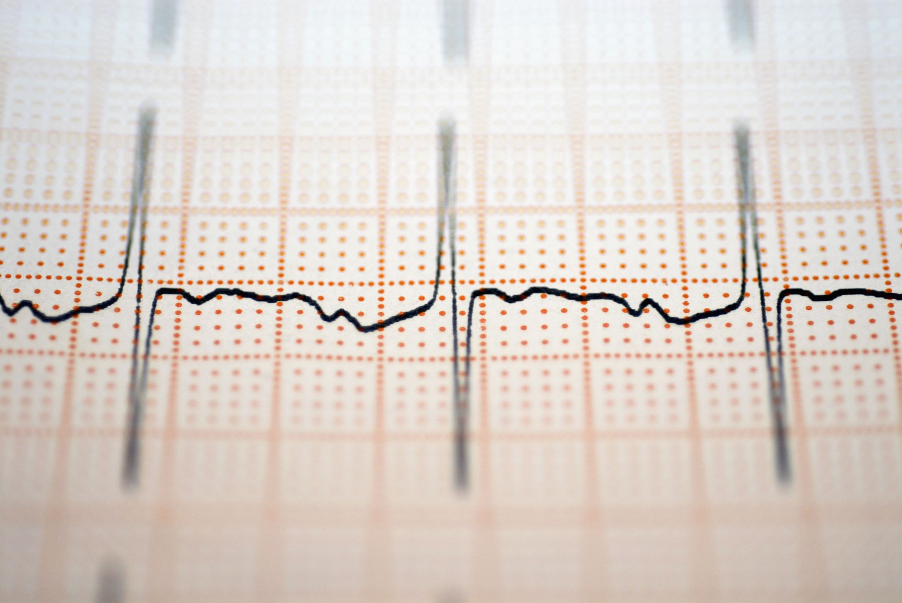
Using Machine Learning to Predict Hypertension
Tiffany Davidson
Applied Science and Analytics
Spring 24
Machine Learning Data 303-1

Slide 2
Question
Do the odds of developing hypertension increase with certain variables? Can we use machine learning to predict if an individual will develop hypertension?

Slide 3

Introduction
Hypertension, or having a blood pressure, is where the Systolic reading is 140 mm Hg or higher and the Diastolic reading is 90 mm Hg or higher. It is costly and often difficult to manage. Hypertension is a risk factor for cardiovascular diseases including strokes. (Appel, Lawrence, 2003). Lowering blood pressure can decrease heart attacks and heart failure. Medication and adjusting lifestyle habits are the usual approaches to treating hypertension. Increasing your intake of potassium, reducing body weight, and a reduction of salt intake are some of the recommended actions to combat hypertension. (Appel, Lawrence, 2003).

Slide 4

Purpose of Research
Previous research has focused on hypertension as a component of cardiovascular health. I found that multiple variables such as age and lifestyle choices had been discussed but when doing nutrition counseling many times patients did not grasp the big picture. The purpose of this research is to explore what variables that the public can control, play a role in the likelihood of developing hypertension.

Slide 5

Previous Machine Learning Methods
The article, “Prediction of Incident Hypertension Within the Next Year: Prospective Study Using Statewide Electronic Health Records and Machine Learning”, utilized the data from patient electronic health records. XGBoost, a machine learning algorithm was used in feature selection and to model build. The algorithm created classification trees and gave a final predictive risk score to each participant. They found that the population most at risk were those over the age of 50 with chronic conditions. Chengyin Y, et al 2018

Slide 6

Previous Machine Learning Methods
In the research article “A Machine-Learning-Based Prediction Method for Hypertension Outcomes Based on Medical Data”, the researchers initially extracted information from the patients and then proceeded to use that information to predict the possibility of hypertension. They proposed a model that combined recursive feature elimination with a cross-validation method and classification algorithm. They used four classification algorithms (support vector machine (SVM), C4.5 decision tree, random forest (RF), and extreme gradient boosting (XGBoost)) to predict patient outcomes by using their optimal features subset. XGBoost was found to be the best prediction performance, and its accuracy, F1, and area under receiver operating characteristic curve (AUC) values are 94.36%, 0.875, and 0.927, respectively, using the optimal features subset. Chang W, 2019

Slide 7


Mount the data set

Slide 8
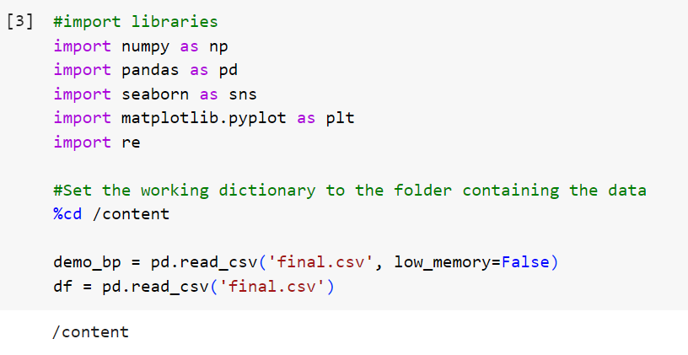
Imports and setting the working directory

Slide 9
Data
The National Health and Nutrition Examination Survey (NHANES) provided the data. NHANES is a series of studies designed to analyze the health and nutritional status of adults and children in the United States. It uses interviews coupled with physical exams. NHANES is a program under the National Center for Health Statistics (NCHS) which is part of the Centers for Disease Control and Prevention (CDC).
The datasets used came from the NHANES 2017 March 2020 Pre-Pandemic data. It contained the demographics, BMI, Blood pressure, and smoking data from that time. I chose this set to study the effects that age, smoking, BMI, gender, race, and having high cholesterol have on hypertension or high blood pressure. The study examines the question: Can we build a model to predict a person’s likelihood of developing hypertension based on these variables?

Slide 10

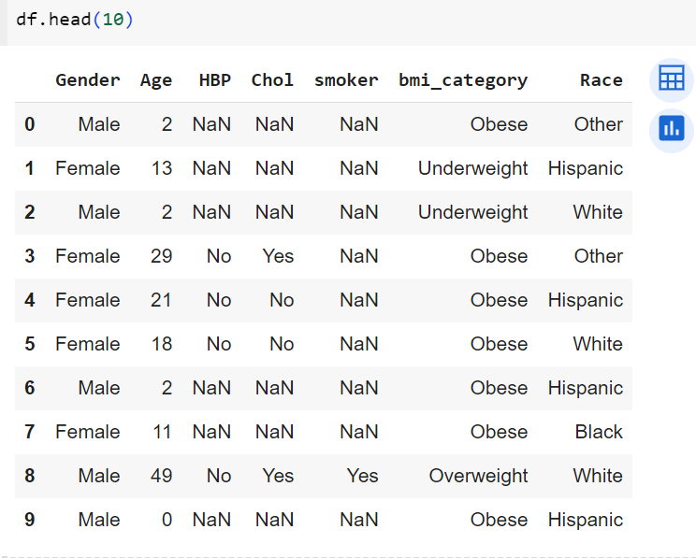
Exploratory Data Analysis and Visualization

Slide 11
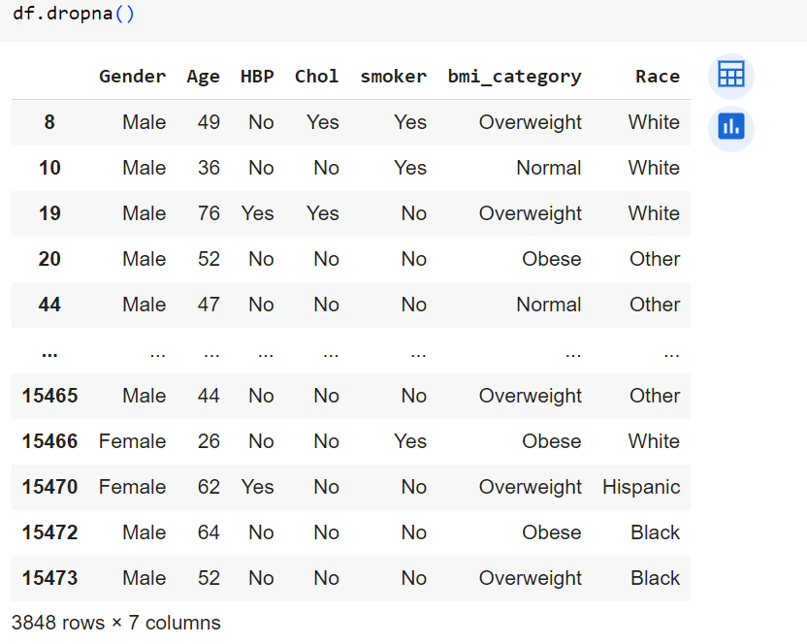
Exploratory Data Analysis and Visualization

Slide 12
Issues
Categories for adult BMI had to be created.
Example: Underweight BMI for an adult is under 18.5(k/m^2)
The ‘Yes’ and ‘Sometimes’ responses for smoking were combined into one category as yes.

Slide 13
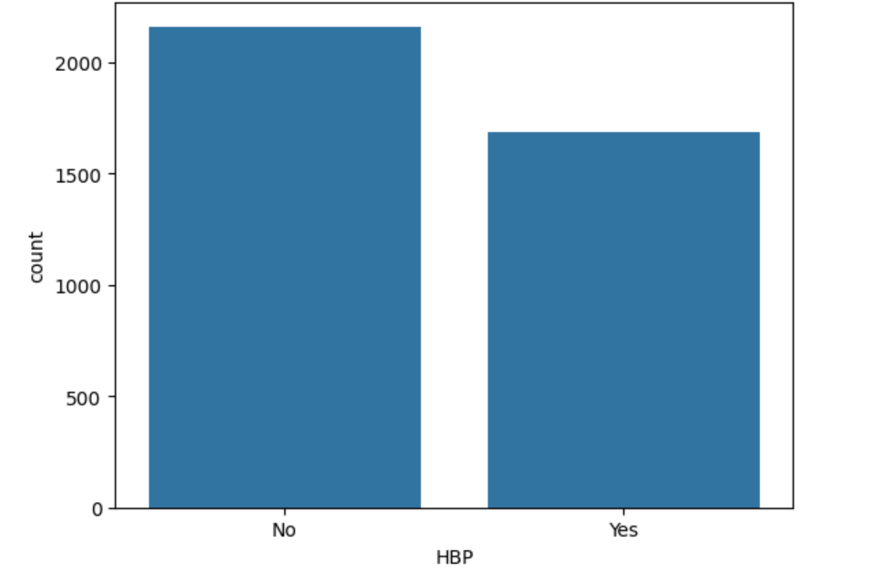
Plotting the data
Count for high blood pressure

Slide 14
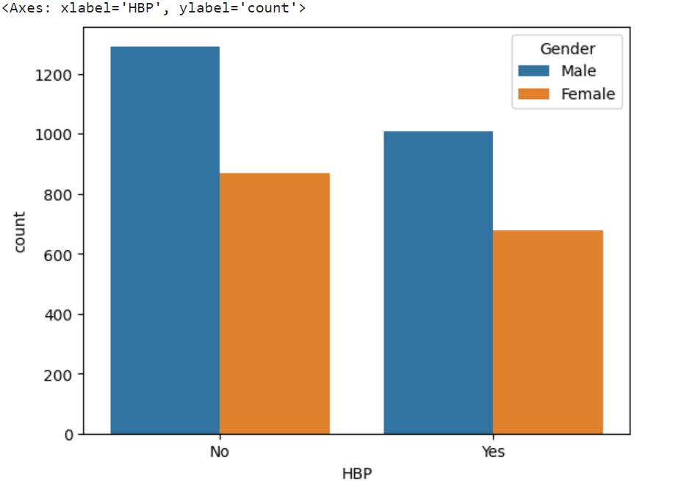
Plotting the data
Comparing high blood pressure between men and women

Slide 15
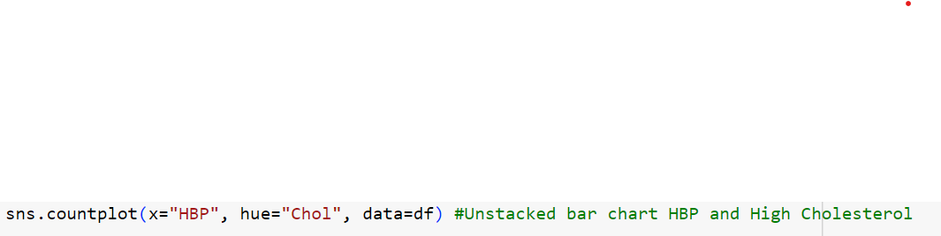
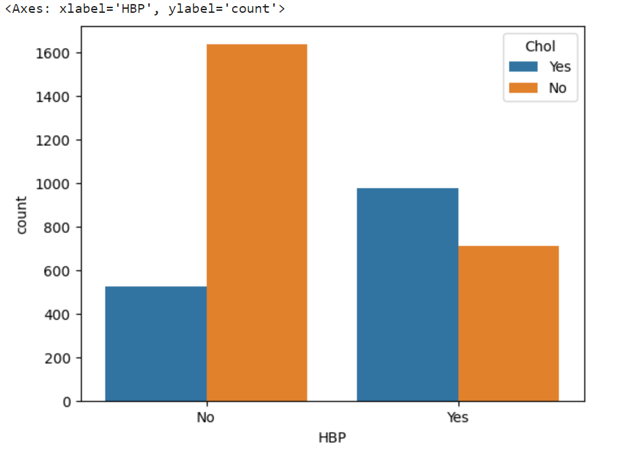
Plotting the data
High blood pressure and high cholesterol.

Slide 16
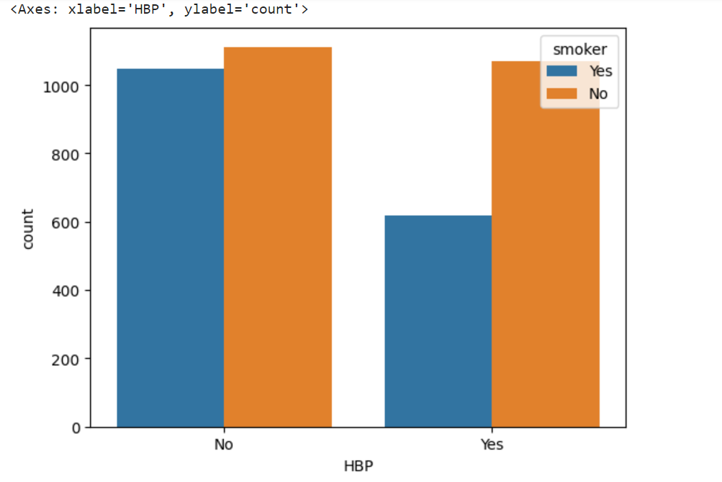
Plotting the data
Comparing high blood pressure in smokers

Slide 17
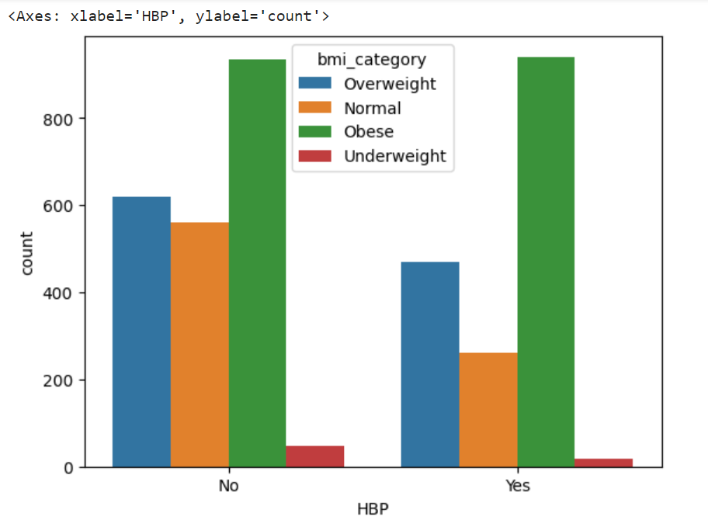
Plotting the data
Comparing high blood pressure among different BMI categories

Slide 18
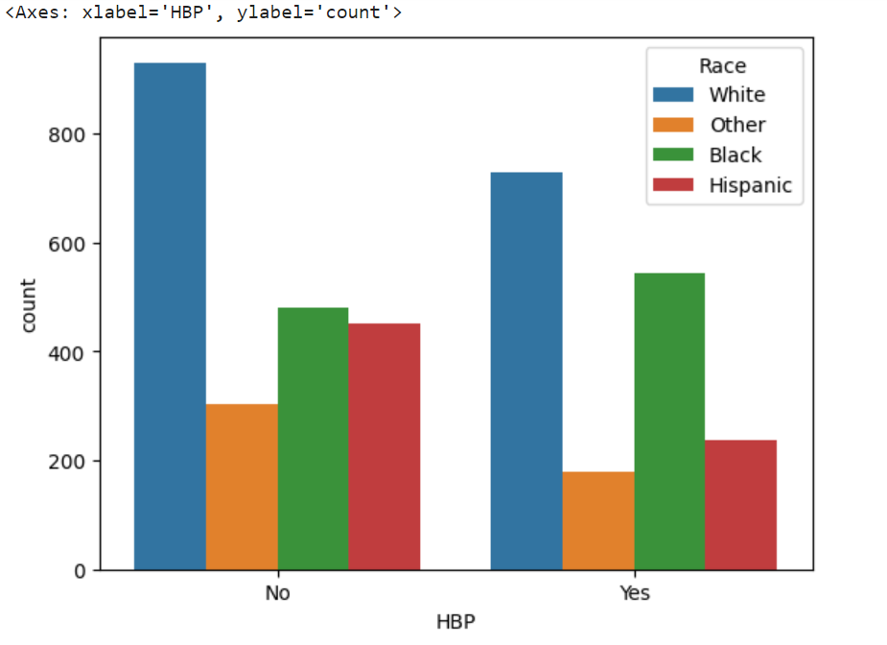
Plotting the data
Comparing high blood pressure among different races.

Slide 19
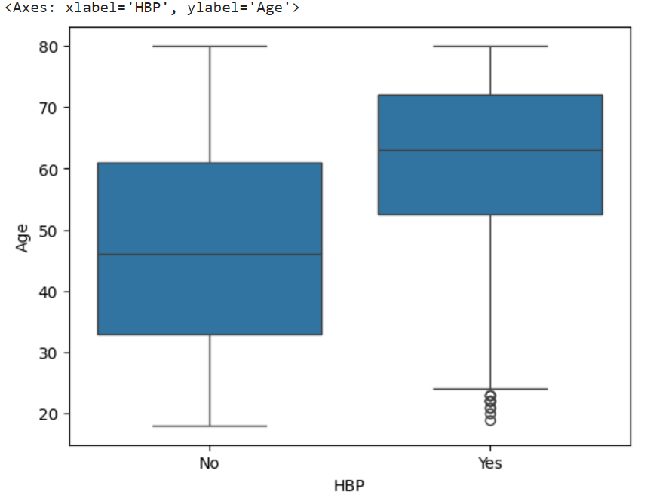
Plotting the data
Comparing high blood pressure among ages.

Slide 20
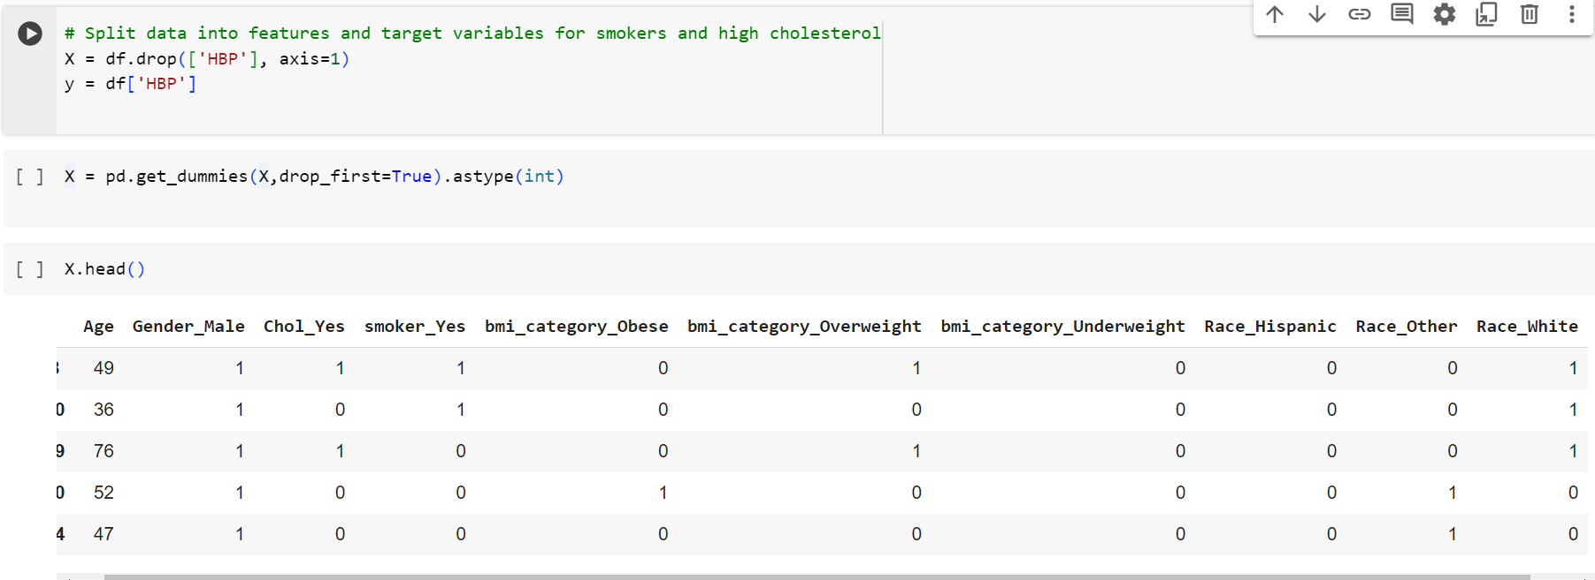
Train|Test Split and Scaling

Slide 21
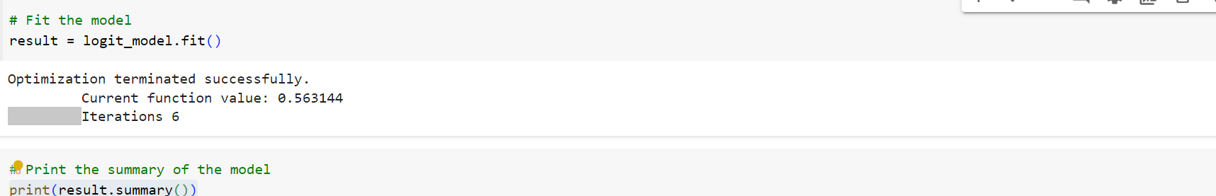
Fit and Summary

Slide 22
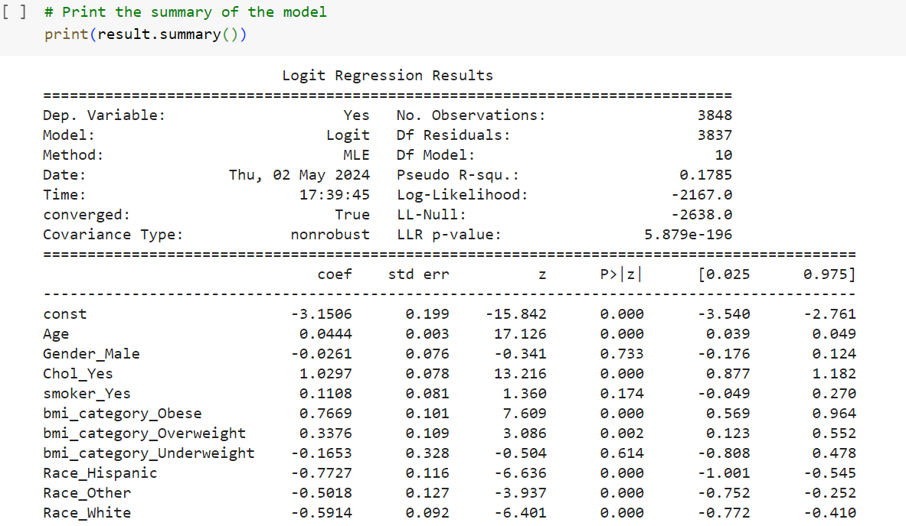
Logit Regression Results
Age and high cholesterol are significant.
Patients who are older and have high cholesterol are also more likely to have high blood pressure.

Slide 23
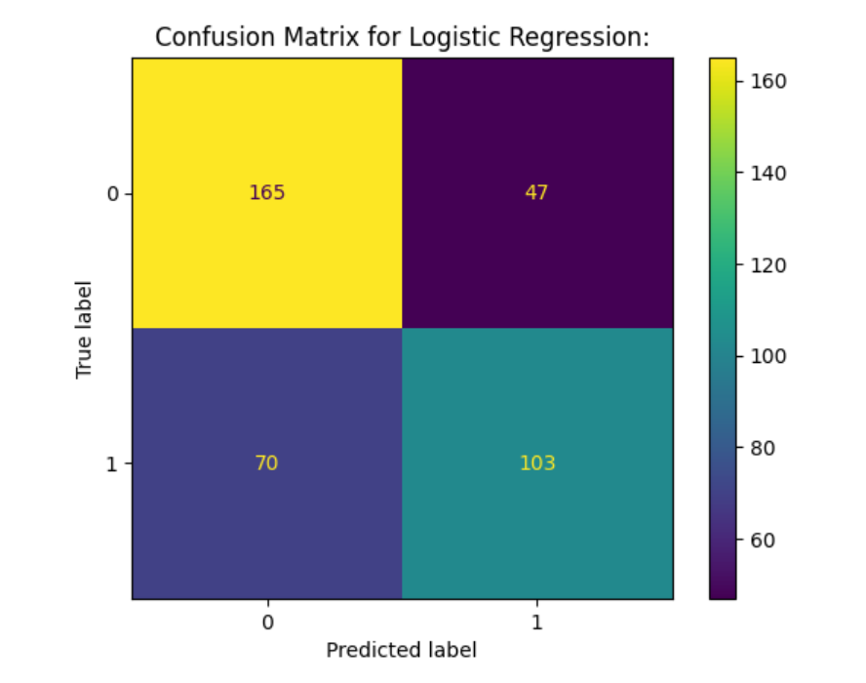
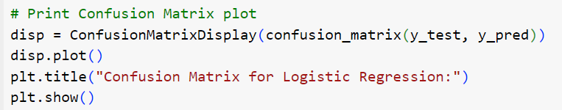
Confusion Matrix for Logistic Regression

Slide 24
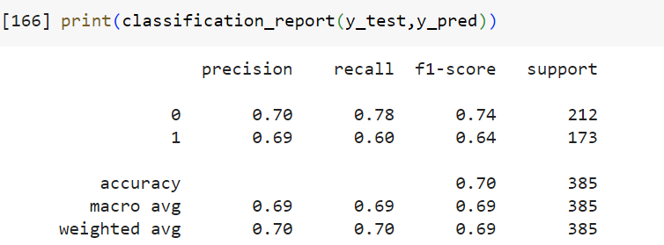
Classification Report y_test, y_predict

Slide 25
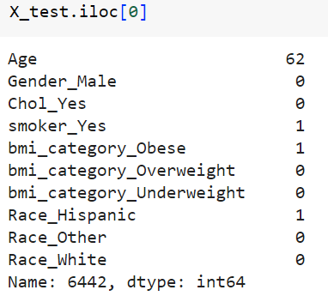
Test data
In the test data we split the data into training and testing. We tested a 62-year-old smoker who was obese. When the test was checked, the response was yes. This means that from the data this person has hypertension. We predict that given these features they have hypertension so the model predicted correctly.

Slide 26
Plans
I am a previous nutritional science major and I have an interest in cardiovascular issues. I want to further the research on the relationship between lifestyle and hypertension. I will also continue to study the machine-learning methods that the previous researchers have used as well as other variables that may contribute to hypertension.

Slide 27
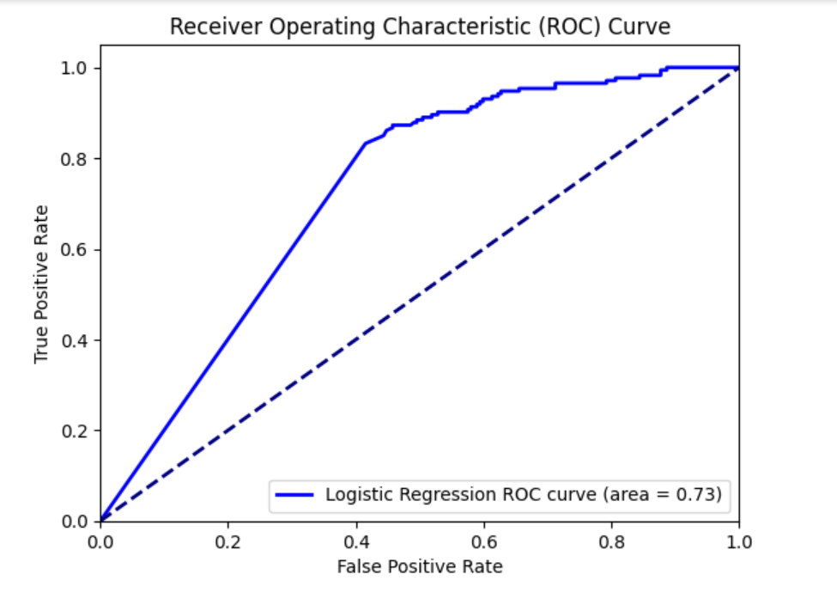
ROC Curve and Area for Logistic Regression

Slide 28
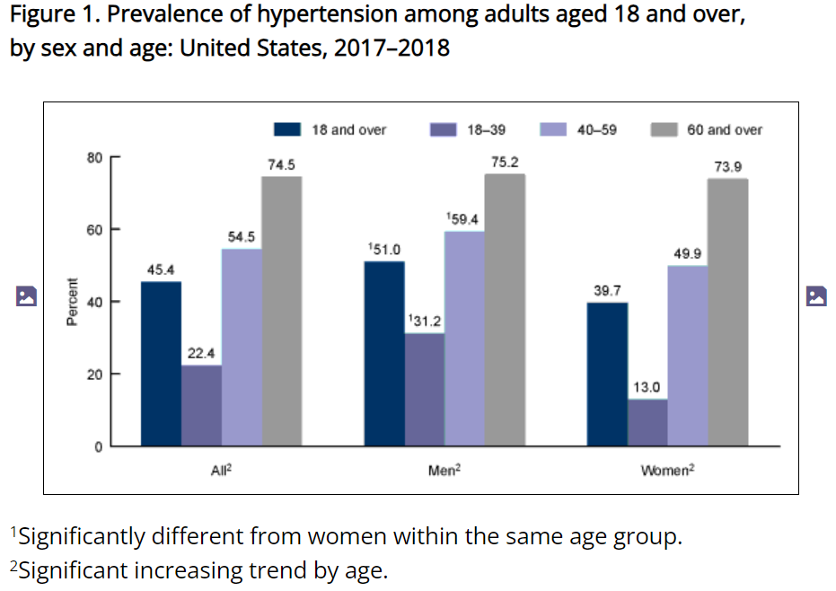
Conclusion
The current research supports the idea that the risk for hypertension for middle-aged and elderly people is 90%. It is understood that hypertension increases with age and other comorbidities like high cholesterol. However, a clear relationship is not well documented. The underlying theme is that the increase in a person’s age also increases other risk factors that lead to hypertension. This is important information for stakeholders because it shows that the aging population is at risk for developing hypertension. For example, this can be used by lobbyists to demonstrate the importance of medical nutrition therapy in healthcare. It also proves the need for additional education on cardiovascular health at every age.
CDC Hypertension Prevalence Among Adults Aged 18 and Over: United States, 2017–2018

Slide 29
References
Appel, Lawrence J. "Lifestyle modification as a means to prevent and treat high blood pressure." Journal of the American Society of Nephrology 14.suppl_2 (2003): S99-S102.
Chang W, Liu Y, Xiao Y, Yuan X, Xu X, Zhang S, Zhou S. A Machine-Learning-Based Prediction Method for Hypertension Outcomes Based on Medical Data. Diagnostics. 2019; 9(4):178. https://doi.org/10.3390/diagnostics9040178
Fuchs, Flávio D., and Paul K. Whelton. "High blood pressure and cardiovascular disease." Hypertension 75.2 (2020): 285-292.
Jung, C., Jung, S. H., Lee, B., Rosenberg, M., Reaven, G. M., & Kim, S. H. (2017). Relationship among age, insulin resistance, and blood pressure. Journal of the American Society of Hypertension, 11(6), 359-365.e2. https://doi.org/10.1016/j.jash.2017.04.005
Gordon T McInnes, How important is optimal blood pressure control? Clinical Therapeutics, Volume 26, Supplement A, 2004, Pages A3-A11, ISSN 0149-2918, https://doi.org/10.1016/S0149-2918(04)90140
Erin D. Michos & Sadiya S. Khan (2021) Further understanding of ideal cardiovascular health score metrics and cardiovascular disease, Expert Review of Cardiovascular Therapy, 19:7, 607-617, DOI: 10.1080/14779072.2021.1937127
Mosca, Irene, Bláithín Ní Bhuachalla, and Rose Anne Kenny. "Explaining significant differences in subjective and objective measures of cardiovascular health: evidence for the socioeconomic gradient in a population-based study." BMC cardiovascular disorders 13 (2013): 1-8.
Jonathan Myers Exercise and Cardiovascular Health Originally published7 Jan 2003 https://doi.org/10.1161/01.CIR.0000048890.59383.8DCirculation. 2003;107:e2–e5
Vasan RS, Beiser A, Seshadri S, et al. Residual Lifetime Risk for Developing Hypertension in Middle-aged Women and Men: The Framingham Heart Study. JAMA. 2002;287(8):1003–1010. doi:10.1001/jama.287.8.1003
Prediction of Incident Hypertension Within the Next Year: Prospective Study Using Statewide Electronic Health Records and Machine Learning Ye C, Fu T, Hao S, Zhang Y, Wang O, Jin B, Xia M, Liu M, Zhou X, Wu Q, Guo Y, Zhu C, Li Y, Culver D,Alfreds S, Stearns F, Sylvester K, Widen E, McElhinney D, Ling X
J Med Internet Res 2018;20(1):e22
URL: https://www.jmir.org/2018/1/e22
DOI: 10.2196/jmir.9268

